Slide 2
Schedule
8:00 – Gather. Request people to unwind from hecticness of their lives. Place burdens and heaviness on God – for God is able to give us rest
8:02 – Sing “How Great Is Our God”
8:07 – Talk about the break up
8:40 – have communion (Scripture reading?)

Slide 3
Impromptu Role Play
We need
Jesus
Woman
Two representative Pharisees
Everyone else will be a Pharisee

Slide 4
How this works
Text in black, we all read together As the actors act
- See text in red to see how we should act
- Text in blue is the kind of emotions we should put into the story
Have fun playing out the lines
You’re also welcome to exaggerate the scenes, but stick with the story (or at least bring it back!)

Slide 5
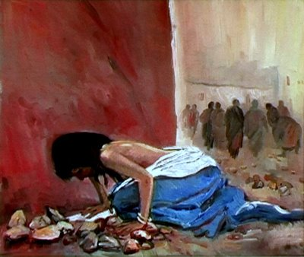
Story of Acceptance from John 8
As Jesus was speaking at the temple, the teachers of religious law and the Pharisees brought a woman who had been caught in the act of adultery. They put her in front of the crowd.
Treat her like an object
she’s going to die anyway!
She’s a terrible sinner

Slide 6
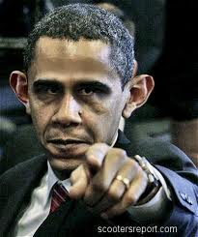
Story of Acceptance from John 8
“Teacher,” they said to Jesus, “this woman was caught in the act of adultery. The law of Moses says to stone her. What do you say?”
Point your fingers at her in disdain, it’s her fault, she is to blame for her wrongdoing

Slide 7
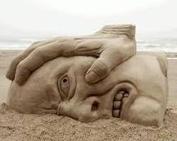
Story of Acceptance from John 8
They were trying to trap him into saying something they could use against him, but Jesus stooped down and wrote in the dust with his finger. They kept demanding an answer
Look to Jesus in anger! “Jesus, she deserves to die!!! Why are you wasting time? Condemn her now!”

Slide 8
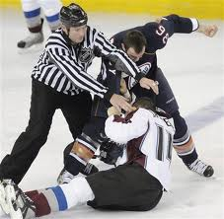
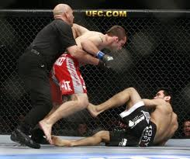
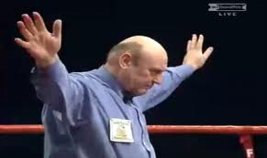
Story of Acceptance from John 8
So he stood up again and said, “All right, but let the one who has never sinned throw the first stone!” Then he stooped down again and wrote in the dust. When the accusers heard this, they slipped away one by one, beginning with the oldest, until only Jesus was left in the middle of the crowd with the woman.

Slide 9
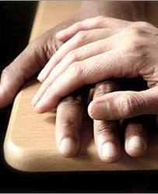
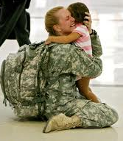
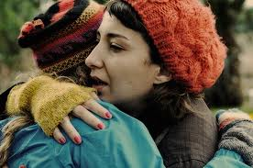
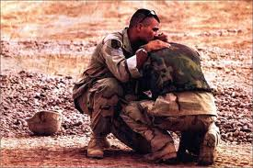
Story of Acceptance from John 8
Then Jesus stood up again and said to the woman, “Where are your accusers? Didn’t even one of them condemn you?”
“No, Lord,” she said.
And Jesus said, “Neither do I. Go and sin no more.”

Slide 10
Story of a break up
Timed presentation, let’s see how this works out
(Starts with the next click)

Slide 11
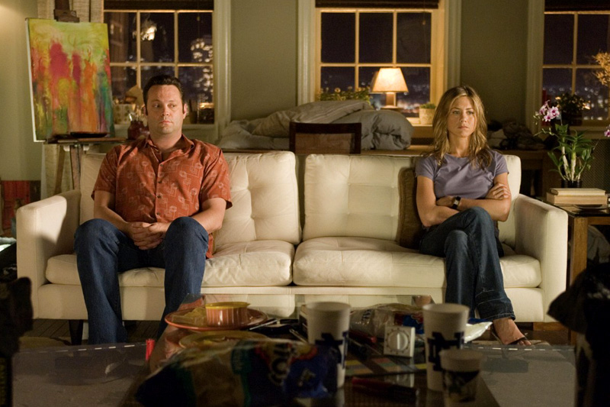
Notes:
Some of you may be able to relate to this. A guy that I knew very closely, he hooked up with a girl and they broke up in three weeks. This break up hurt both people individually.
Now, let me give you more details on how this happened

Slide 12
The guy
He met Jesus during his Sophomore year in HS. He committed his life to Jesus.

Slide 13
Raise Your Hands if you can say
I Love Jesus,
He’s my Lord and Savior
Notes:
Talk about perhaps Christians being able to relate to this guy, non-Christians/Christians alike can relate to the girl
###

Slide 14
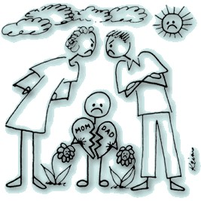
Notes:
Though the guy was generally a good person who was in love with Jesus, his parents started fighting in his junior year, and eventually divorced in his senior year.

Slide 15
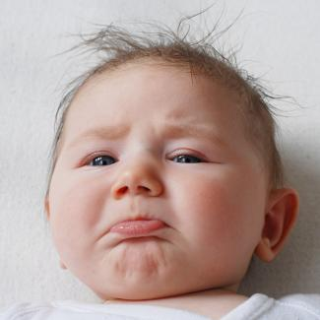
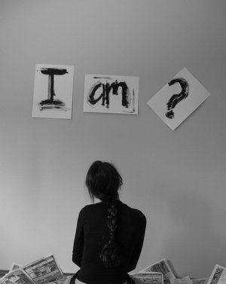
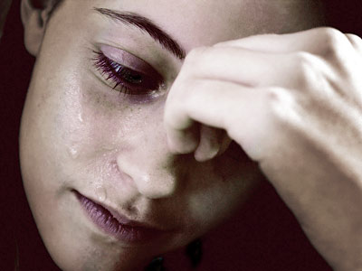
Notes:
He was sad and heartbroken. He was confused. This all happened at a time when he had to choose a college, a career path, and figure out what he wanted in life.
He just broke down and decided that God wasn’t as good as he thought.
Feeling deserted and rejected by God and his family, he could no longer trust anyone.

Slide 16
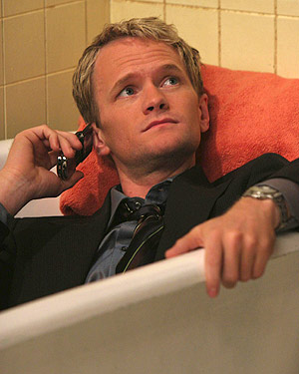
I got my smarts
I got my
good looks
I’m OK
Notes:
Since he couldn’t trust anyone, he had no place to turn but to himself.
This was the way he coped . . . Even though he had many hurts inside, he had to act as if everything was ok, that he’s doing ok.

Slide 17
Notes:
The divorce caused him to be away from his mom, who took care of him most of his life while the father worked.
He never sought out relationships because he always believed that God had one person prepared for him . . . He didn’t want to date around, meet many women, but with one person God chooses for him, he wanted to love for all his life.
So he prayed asking God to find him a mate that he can love for all time.
Yet, the response he felt from God was to wait.

Slide 18
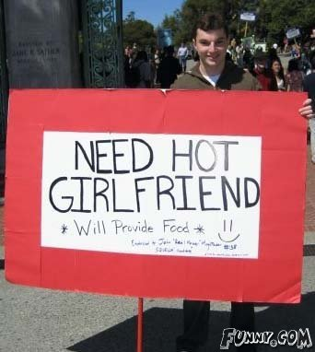
Notes:
Already feeling rejected from God, he felt God didn’t care, and decided to just find anyone to suit his need.
Fortunately, the girl he met was very beautiful, but with a set of burdens of her own.
This was his sophomore year in college.

Slide 19
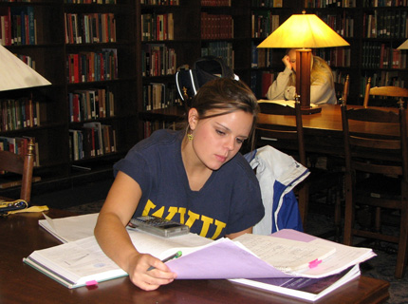
The girl
Notes:
Due to unknown reasons, she didn’t have much family connections. She may have had the same circumstances as the guy, but I do not know. All I know was she was trying to make ends meet by taking classes, working two waitress jobs, and taking care of her younger sister who was in high school.
She had to enroll her sister to the local high school by her college campus and drive her back and forth everyday. She lived a very tough life, but she grew accustomed to such a difficult lifestyle.

Slide 20
Seeking Acceptance
Notes:
She’s not gone to church most of her life, but she began to attend Sunday services.
Perhaps she was looking for friendships
Perhaps a place to unwind from her uneasy life
Or perhaps she was just looking for hope, a promise of something better
Then at church, she found someone that took interest in her, seeming to be a very devout Christian – and she wanted to take comfort knowing that a person of God would accept her as she is

Slide 21
Notes:
Being very attractive, the guy took interest in her, asked her out, and they began to go steady.
They were happy together and enjoyed a good two weeks of fun, closeness and intimacy they both longed for.

Slide 22
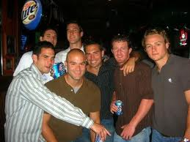
The Truth
Notes:
On a guys night out, one of the older guys talked about how happy the guy must be to go out with such a pretty girl. Then he proceeded to say, “but did you know she’s a whore?”
The guy asked, “what do you mean?”
The older guy replied, “she looks like she’s been with a lot of guys”

Slide 23
Confused and unforgiving
Notes:
He was confused. He had always saved himself for marriage (for the one person he would love for all his life), and he expected the same from the girl he would love.
Wanting to know the truth, the guy asked the girl.
The girl truly loved the guy, and was happy to be with him. Though this part of her past was a secret, because she cared, she told him the truth. She had been with few other guys and had slept with some of them.
This broke the guy’s heart. At first, he didn’t act as if it mattered, but he couldn’t accept the fact that even though he has been able to keep himself, she hadn’t.
Eventually, he told her straight out – why don’t you go back to those guys you slept with and ask them to take you back? And then they broke up, their relationship lasting three weeks.

Slide 24
Afterwards
Notes:
While the guy was well accepted in the church because of his comfort within the church settings, the girl required more time.
After the break up, the girl continued to come to church, but she felt more alienated, especially with the guy’s presence – and eventually, she stopped coming. She could not find the hope she was looking for in the church. She has probably lost all hope in God.

Slide 25
Many heartbroken people in the world (both Christians and non-Christians)
Like the girl in the story
We have many hurts
From family
Relationships
Responsibilities
We are hoping for something
A good job/source of income
A good bf/gf, wife/husband
Happiness and joy in our lives

Slide 26
Christians that do not understand the grace of God (The guy)

